Slide 1
Trabalho prático fundamentos de banco de dados
Fórmula 1 database
20/01/2022

Slide 2

Conteúdo do banco de dados
O banco de dados abordado no trabalho é um banco de dados sobre Fórmula 1 trazendo dados de pilotos, corridas, temporadas, circuitos e entre outros elementos do esporte, contando com 14 tabelas em sua estrutura, onde sua alimentação e esquema foi pego do site Ergast.

Slide 3
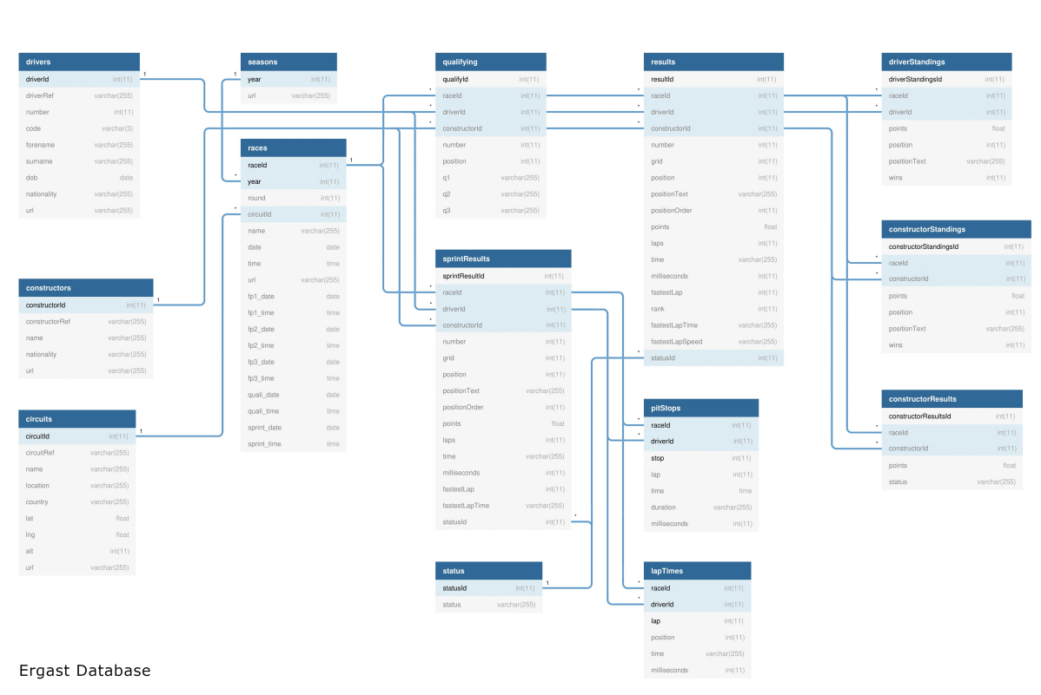
Modelo Relacional:

Slide 4
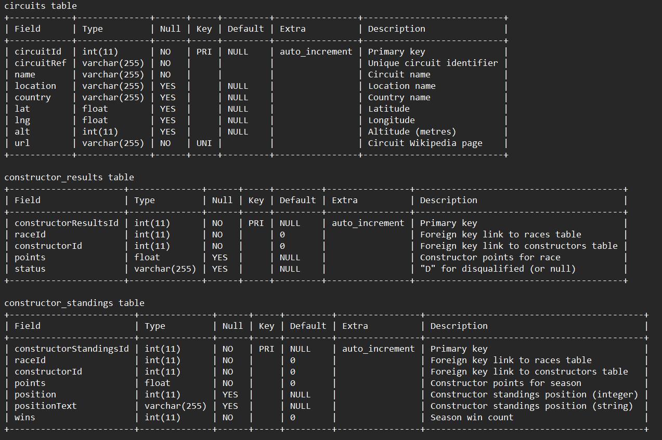
Estrutura das tabelas:

Slide 5
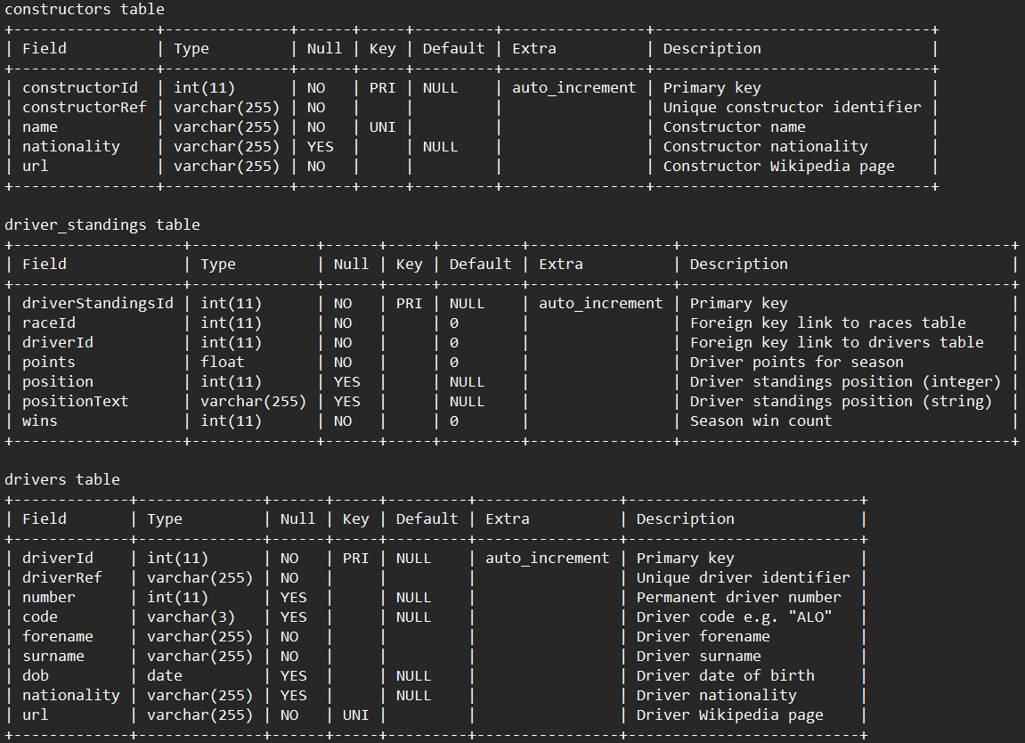
Estrutura das tabelas:

Slide 6
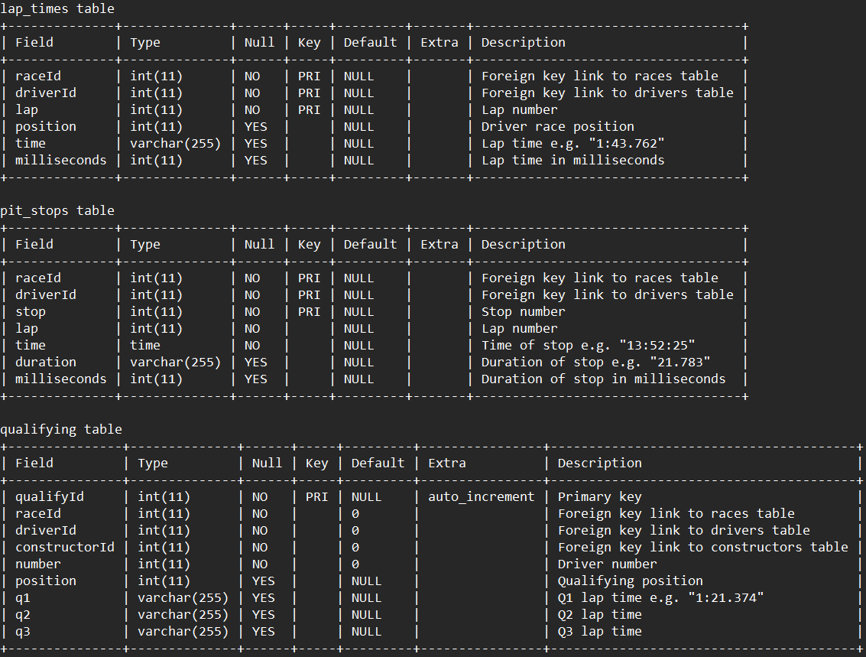
Estrutura das tabelas:

Slide 7
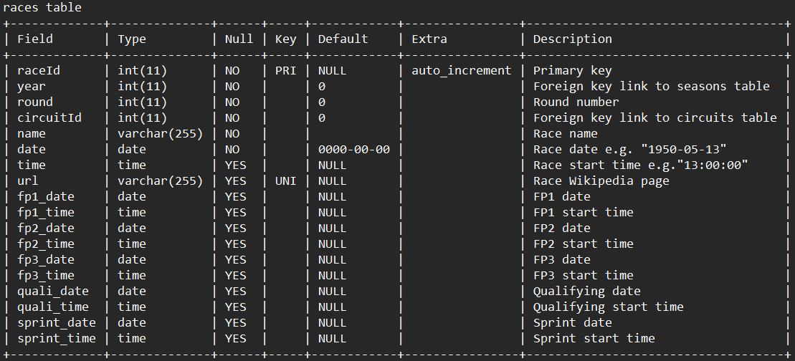
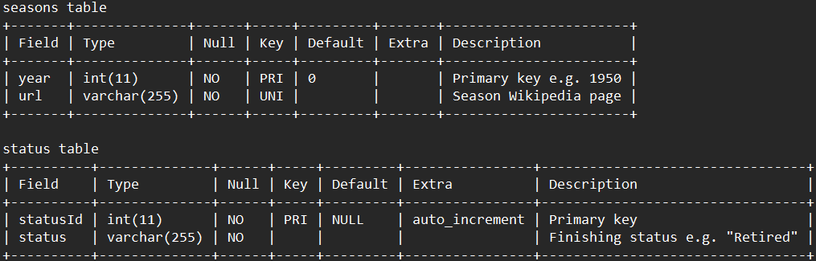
Estrutura das tabelas:

Slide 8
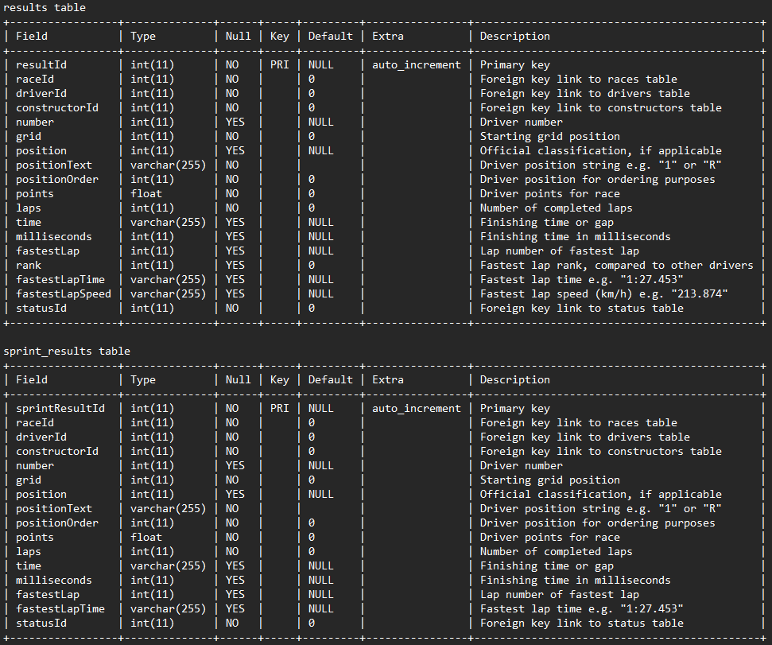
Estrutura das tabelas:

Slide 9
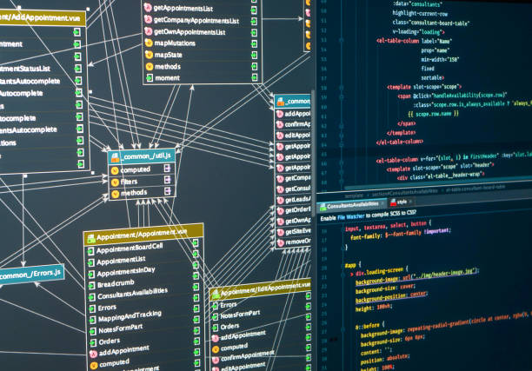
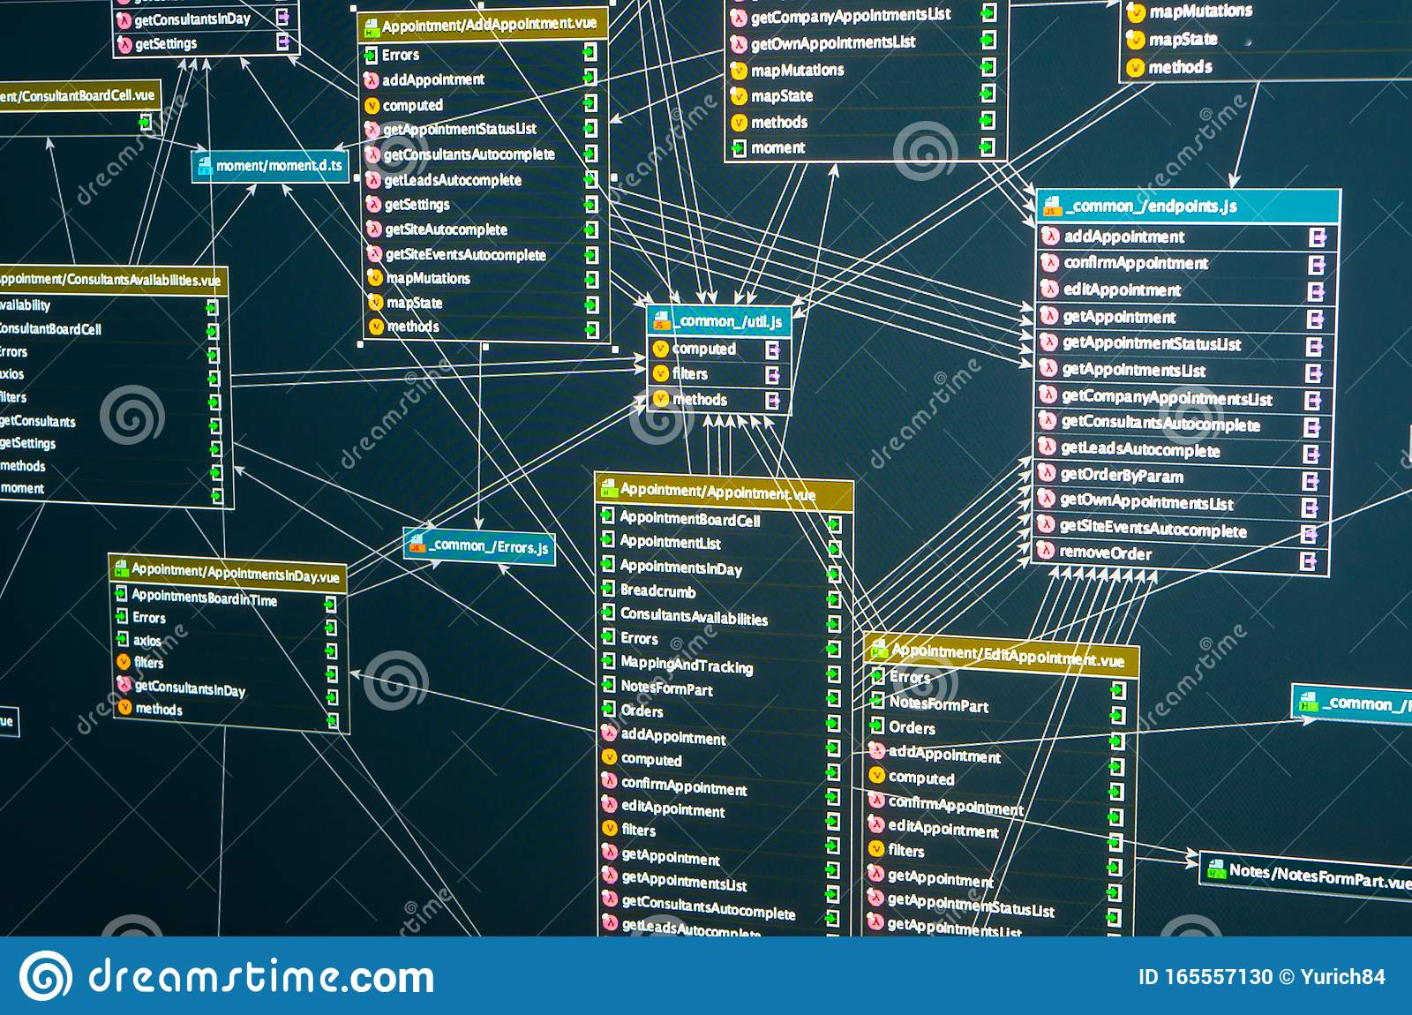
Parte 2: INTEGRAÇÃO
O segundo banco de dados, também sobre Fórmula 1, os dados diferiam um pouco e o esquema era um subconjunto do nosso.
O segundo banco possui dois pilotos que não constam no nosso: Oscar Piastri e Logan Sargeant.
Em vista disso, descobrimos uma versão atualizada do nosso banco de dados datada de 7 de janeiro, que contém esses dois pilotos.
Notamos divergências em dois nomes de construtoras:
No deles: Alpine;
no nosso: Alpine F1 Team.
No deles: Red Bull Racing;
no nosso: Red Bull.

Slide 10
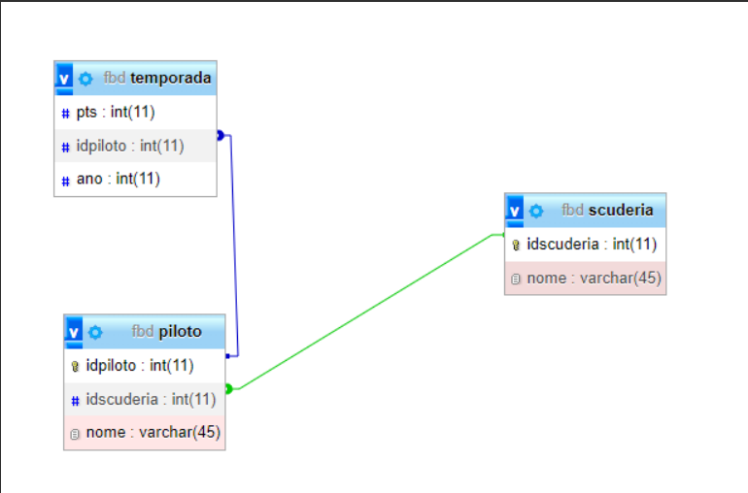
Modelo Relacional segundo banco:

Slide 11

CONSULTAS SQL
1 - SELECT COUNT(results.resultId) AS winsCount, CONCAT(drivers.forename, ' ' , drivers.surname)
FROM results
INNER JOIN drivers
ON results.driverId = drivers.driverId AND results.position = 1
GROUP BY drivers.driverId
ORDER BY COUNT(results.resultId) DESC
2 - SELECT COUNT(results.resultId) AS podiumCount, CONCAT(drivers.forename, ' ' , drivers.surname)
FROM results
INNER JOIN drivers
ON results.driverId = drivers.driverId AND results.position <= 3
GROUP BY drivers.driverId
ORDER BY COUNT(results.resultId) DESC
DESCRIÇÃO: Quais pilotos ganharam mais corridas
DESCRIÇÃO: Quais pilotos mais ficaram no pódio

Slide 12
winsCount | CONCAT(drivers.forename, ' ' , drivers.surname)
103 | Lewis Hamilton
91 | Michael Schumacher
53 | Sebastian Vettel
51 | Alain Prost
41 | Ayrton Senna
35 | Max Verstappen
32 | Fernando Alonso
31 | Nigel Mansell
27 | Jackie Stewart
25 | Niki Lauda
25 | Jim Clark
24 | Juan Fangio
23 | Nico Rosberg
23 | Nelson Piquet
22 | Damon Hill
21 | Kimi Räikkönen
20 | Mika Häkkinen
16 | Stirling Moss
15 | Jenson Button
14 | Emerson Fittipaldi
14 | Jack Brabham
14 | Graham Hill
13 | Alberto Ascari
13 | David Coulthard
12 | Alan Jones
12 | Carlos Reutemann
12 | Mario Andretti
11 | Jacques Villeneuve
11 | Rubens Barrichello
11 | Felipe Massa
10 | James Hunt
10 | Valtteri Bottas
10 | Gerhard Berger
10 | Jody Scheckter
10 | Ronnie Peterson
9 | Mark Webber
8 | Daniel Ricciardo
8 | Denny Hulme
8 | Jacky Ickx
7 | Juan Pablo Montoya
7 | René Arnoux
6 | Tony Brooks
6 | Gilles Villeneuve
6 | Jacques Laffite
6 | Jochen Rindt
6 | Ralf Schumacher
6 | Riccardo Patrese
6 | John Surtees
5 | Nino Farina
5 | Charles Leclerc
5 | Michele Alboreto
5 | Keke Rosberg
5 | John Watson
5 | Clay Regazzoni
4 | Sergio Pérez
4 | Bruce McLaren
4 | Eddie Irvine
4 | Dan Gurney
3 | Thierry Boutsen
3 | Mike Hawthorn
3 | Peter Collins
3 | Phil Hill
3 | Heinz-Harald Frentzen
3 | Didier Pironi
3 | Giancarlo Fisichella
3 | Johnny Herbert
2 | Bill Vukovich
2 | Jo Siffert
2 | José Froilán González
2 | Maurice Trintignant
2 | Elio de Angelis
2 | Wolfgang von Trips
2 | Jean-Pierre Jabouille
2 | Pedro Rodríguez
2 | Patrick Depailler
2 | Peter Revson
2 | Patrick Tambay
1 | Ludovico Scarfiotti
1 | Peter Gethin
1 | Richie Ginther
1 | François Cevert
1 | Alessandro Nannini
1 | Lorenzo Bandini
1 | Carlos Pace
1 | Jimmy Bryan
1 | Jarno Trulli
1 | Jochen Mass
1 | Olivier Panis
1 | Piero Taruffi
1 | Pierre Gasly
1 | Vittorio Brambilla
1 | Jean Alesi
1 | Troy Ruttman
1 | Lee Wallard
1 | Robert Kubica
1 | Esteban Ocon
1 | Giancarlo Baghetti
1 | Sam Hanks
1 | Luigi Fagioli
1 | Heikki Kovalainen
1 | Carlos Sainz
1 | Innes Ireland
1 | Luigi Musso
1 | Johnnie Parsons
1 | George Russell
1 | Jim Rathmann
1 | Jean-Pierre Beltoise
1 | Pat Flaherty
1 | Rodger Ward
1 | Bob Sweikert
1 | Pastor Maldonado
1 | Gunnar Nilsson
1 | Jo Bonnier

Slide 13
podiumCount | CONCAT(drivers.forename, ' ' , drivers.surname)
191 | Lewis Hamilton
155 | Michael Schumacher
122 | Sebastian Vettel
106 | Alain Prost
103 | Kimi Räikkönen
98 | Fernando Alonso
80 | Ayrton Senna
77 | Max Verstappen
68 | Rubens Barrichello
67 | Valtteri Bottas
62 | David Coulthard
60 | Nelson Piquet
59 | Nigel Mansell
57 | Nico Rosberg
54 | Niki Lauda
51 | Mika Häkkinen
50 | Jenson Button
48 | Gerhard Berger
45 | Carlos Reutemann
43 | Jackie Stewart
42 | Damon Hill
42 | Mark Webber
41 | Felipe Massa
37 | Riccardo Patrese
36 | Graham Hill
35 | Emerson Fittipaldi
35 | Juan Fangio
33 | Jody Scheckter
33 | Denny Hulme
32 | Jean Alesi
32 | Daniel Ricciardo
32 | Jim Clark
32 | Jacques Laffite
31 | Jack Brabham
30 | Juan Pablo Montoya
28 | Clay Regazzoni
27 | Bruce McLaren
27 | Ralf Schumacher
26 | Eddie Irvine
26 | Sergio Pérez
26 | Ronnie Peterson
25 | Jacky Ickx
24 | Alan Jones
24 | Stirling Moss
24 | Charles Leclerc
24 | John Surtees
23 | Michele Alboreto
23 | Jacques Villeneuve
23 | James Hunt
22 | René Arnoux
20 | John Watson
20 | Nino Farina
19 | Mario Andretti
19 | Dan Gurney
19 | Patrick Depailler
19 | Giancarlo Fisichella
18 | Heinz-Harald Frentzen
18 | Mike Hawthorn
17 | Alberto Ascari
17 | Keke Rosberg
16 | Phil Hill
15 | José Froilán González
15 | Thierry Boutsen
15 | Carlos Sainz
14 | Richie Ginther
13 | Jochen Rindt
13 | Nick Heidfeld
13 | Didier Pironi
13 | Gilles Villeneuve
13 | François Cevert
12 | Stefan Johansson
12 | Robert Kubica
11 | Jarno Trulli
11 | Patrick Tambay
11 | Chris Amon
10 | Maurice Trintignant
10 | Tony Brooks
10 | Romain Grosjean
9 | Peter Collins
9 | Elio de Angelis
9 | Jean Behra
9 | George Russell
9 | Eddie Cheever
9 | Martin Brundle
9 | Alessandro Nannini
8 | Peter Revson
8 | Jochen Mass
8 | Lorenzo Bandini
8 | Jean-Pierre Beltoise
8 | Luigi Villoresi
7 | Johnny Herbert
7 | Pedro Rodríguez
7 | Luigi Musso
6 | Lando Norris
6 | Carlos Pace
6 | Wolfgang von Trips
6 | Luigi Fagioli
6 | Jo Siffert
5 | Piero Taruffi
5 | Olivier Panis
5 | Andrea de Cesaris
4 | Jim Rathmann
4 | Gunnar Nilsson
4 | Derek Warwick
4 | Innes Ireland
4 | Heikki Kovalainen
4 | Sam Hanks
3 | Ivan Capelli
3 | Tony Maggs
3 | Jimmy Bryan
3 | Timo Glock
3 | Eugenio Castellotti
3 | Daniil Kvyat
3 | Lance Stroll
3 | Jean-Pierre Jarier
3 | Alexander Wurz
3 | Masten Gregory
3 | Mark Blundell
3 | Pierre Gasly
2 | Jos Verstappen
2 | Karl Kling
2 | Alexander Albon
2 | Felice Bonetto
2 | Harry Schell
2 | Louis Rosier
2 | Esteban Ocon
2 | Rudi Fischer
2 | Rodger Ward
2 | Bill Vukovich
2 | Hans-Joachim Stuck
2 | Jack McGrath
2 | Cesare Perdisa
2 | Jackie Oliver
2 | Jean-Pierre Jabouille
2 | Olivier Gendebien
2 | Tom Pryce
2 | Robert Manzon
2 | Onofre Marimón
2 | Stuart Lewis-Evans
2 | Mike Parkes
2 | Piers Courage
2 | Roy Salvadori
2 | Umberto Maglioli
2 | Stefano Modena
2 | Teo Fabi
2 | Mike Hailwood
2 | Mika Salo
2 | Peter Arundell
1 | Art Cross
1 | Richard Attwood
1 | Mauri Rose
1 | Pat Flaherty
1 | Bob Anderson
1 | Kamui Kobayashi
1 | Lucien Bianchi
1 | Roberto Moreno
1 | Don Freeland
1 | Kevin Magnussen
1 | Bruno Giacomelli
1 | Johnny Servoz-Gavin
1 | Peter Whitehead
1 | Aguri Suzuki
1 | Paul Frère
1 | Trevor Taylor
1 | George Follmer
1 | Henri Pescarolo
1 | Troy Ruttman
1 | Nelson Piquet Jr.
1 | Paul Goldsmith
1 | Pedro de la Rosa
1 | John Love
1 | Dorino Serafini
1 | Maurício Gugelmin
1 | Philippe Streiff
1 | Rolf Stommelen
1 | Lee Wallard
1 | Tiago Monteiro
1 | George Amick
1 | Manny Ayulo
1 | Reine Wisell
1 | Mike Nazaruk
1 | Michael Andretti
1 | Willy Mairesse
1 | Takuma Sato
1 | Johnny Boyd
1 | Duane Carter
1 | Alfonso de Portago
1 | Johnny Thomson
1 | Paul Russo
1 | Vittorio Brambilla
1 | Hans Herrmann
1 | Gianni Morbidelli
1 | Ron Flockhart
1 | Giancarlo Baghetti
1 | Reg Parnell
1 | Jyrki Järvilehto
1 | Jo Bonnier
1 | Ludovico Scarfiotti
1 | Vitaly Petrov
1 | Nicola Larini
1 | Tim Schenken
1 | Louis Chiron
1 | Bob Sweikert
1 | Peter Gethin
1 | Johnnie Parsons
1 | Carlos Menditeguy
1 | Mike Spence
1 | Tony Bettenhausen
1 | Mark Donohue
1 | Éric Bernard
1 | Cliff Allison
1 | Brian Redman
1 | Bill Holland
1 | Pastor Maldonado
1 | Jimmy Davies

Slide 14
CONSULTAS SQL
3 - SELECT CONCAT(drivers.forename, ' ' , drivers.surname), COUNT(qualifying.qualifyId) AS poleCount
FROM qualifying
INNER JOIN drivers
ON qualifying.driverId = drivers.driverId AND qualifying.position = 1
GROUP BY drivers.driverId
ORDER BY COUNT(qualifying.qualifyId) DESC
4 - SELECT CONCAT(drivers.forename, ' ' , drivers.surname)
FROM drivers
WHERE drivers.driverId NOT IN (SELECT qualifying.driverId FROM qualifying WHERE qualifying.position = 1)
ORDER BY drivers.driverId
DESCRIÇÃO: Quais pilotos mais largaram em primeiro
DESCRIÇÃO: Quais pilotos nunca largaram em primeiro

Slide 15
CONCAT(drivers.forename, ' ' , drivers.surname) | poleCount
Lewis Hamilton | 106
Sebastian Vettel | 57
Michael Schumacher | 36
Nico Rosberg | 30
Fernando Alonso | 23
Max Verstappen | 20
Kimi Räikkönen | 19
Valtteri Bottas | 19
Charles Leclerc | 17
Felipe Massa | 16
Damon Hill | 13
Mark Webber | 12
Rubens Barrichello | 10
Mika Häkkinen | 10
Jenson Button | 8
Jacques Villeneuve | 7
David Coulthard | 6
Ralf Schumacher | 5
Giancarlo Fisichella | 4
Gerhard Berger | 4
Jarno Trulli | 4
Daniel Ricciardo | 3
Ayrton Senna | 3
Carlos Sainz | 2
Juan Pablo Montoya | 2
Nigel Mansell | 1
Robert Kubica | 1
George Russell | 1
Nico Hülkenberg | 1
Kevin Magnussen | 1
Heikki Kovalainen | 1
Heinz-Harald Frentzen | 1
Lance Stroll | 1
Nick Heidfeld | 1
Lando Norris | 1
Jean Alesi | 1
Sergio Pérez | 1

Slide 16
CONCAT(drivers.forename, ' ' , drivers.surname)
Kazuki Nakajima
Sébastien Bourdais
Timo Glock
Takuma Sato
Nelson Piquet Jr.
Adrian Sutil
Anthony Davidson
Vitantonio Liuzzi
Alexander Wurz
Scott Speed
Christijan Albers
Markus Winkelhock
Sakon Yamamoto
Christian Klien
Tiago Monteiro
Yuji Ide
Franck Montagny
Pedro de la Rosa
Robert Doornbos
Narain Karthikeyan
Patrick Friesacher
Ricardo Zonta
Antônio Pizzonia
Cristiano da Matta
Olivier Panis
Giorgio Pantano
Gianmaria Bruni
Zsolt Baumgartner
Marc Gené
Jos Verstappen
Justin Wilson
Ralph Firman
Nicolas Kiesa
Luciano Burti
Eddie Irvine
Tarso Marques
Enrique Bernoldi
Gastón Mazzacane
Tomáš Enge
Alex Yoong
Mika Salo
Pedro Diniz
Johnny Herbert
Allan McNish
Sébastien Buemi
Toranosuke Takagi
Luca Badoer
Alessandro Zanardi
Stéphane Sarrazin
Ricardo Rosset
Esteban Tuero
Shinji Nakano
Jan Magnussen
Nicola Larini
Ukyo Katayama
Vincenzo Sospiri
Gianni Morbidelli
Norberto Fontana
Pedro Lamy
Martin Brundle
Andrea Montermini
Giovanni Lavaggi
Mark Blundell
Aguri Suzuki
Taki Inoue
Roberto Moreno
Karl Wendlinger
Bertrand Gachot
Domenico Schiattarella
Pierluigi Martini
Jean-Christophe Boullion
Massimiliano Papis
Jean-Denis Délétraz
Gabriele Tarquini
Érik Comas
David Brabham
Éric Bernard
Christian Fittipaldi
Michele Alboreto
Olivier Beretta
Roland Ratzenberger
Paul Belmondo
Jyrki Järvilehto
Andrea de Cesaris
Jean-Marc Gounon
Philippe Alliot
Philippe Adams
Yannick Dalmas
Hideki Noda
Franck Lagorce
Alain Prost
Derek Warwick
Riccardo Patrese
Fabrizio Barbazza
Michael Andretti
Ivan Capelli
Thierry Boutsen
Marco Apicella
Emanuele Naspetti
Toshio Suzuki
Maurício Gugelmin
Eric van de Poele
Olivier Grouillard
Andrea Chiesa
Stefano Modena
Giovanna Amati
Alex Caffi
Enrico Bertaggia
Perry McCarthy
Jan Lammers
Nelson Piquet
Satoru Nakajima
Emanuele Pirro
Stefan Johansson
Julian Bailey
Pedro Chaves
Michael Bartels
Naoki Hattori
Alessandro Nannini
Bernd Schneider
Paolo Barilla
Gregor Foitek
Claudio Langes
Gary Brabham
Martin Donnelly
Bruno Giacomelli
Jaime Alguersuari
Romain Grosjean
Kamui Kobayashi
Jonathan Palmer
Christian Danner
Eddie Cheever
Luis Pérez-Sala
Piercarlo Ghinzani
Volker Weidler
Pierre-Henri Raphanel
René Arnoux
Joachim Winkelhock
Oscar Larrauri
Philippe Streiff
Adrián Campos
Jean-Louis Schlesser
Pascal Fabre
Teo Fabi
Franco Forini
Jacques Laffite
Elio de Angelis
Johnny Dumfries
Patrick Tambay
Marc Surer
Keke Rosberg
Alan Jones
Huub Rothengatter
Allen Berg
Manfred Winkelhock
Niki Lauda
François Hesnault
Mauro Baldi
Stefan Bellof
Kenny Acheson
John Watson
Johnny Cecotto
Jo Gartner
Corrado Fabi
Mike Thackwell
Chico Serra
Danny Sullivan
Eliseo Salazar
Roberto Guerrero
Raul Boesel
Jean-Pierre Jarier
Jacques Villeneuve Sr.
Carlos Reutemann
Jochen Mass
Slim Borgudd
Didier Pironi
Gilles Villeneuve
Riccardo Paletti
Brian Henton
Derek Daly
Mario Andretti
Emilio de Villota
Geoff Lees
Tommy Byrne
Rupert Keegan
Hector Rebaque
Beppe Gabbiani
Kevin Cogan
Miguel Ángel Guerra
Siegfried Stohr
Ricardo Zunino
Ricardo Londoño
Jean-Pierre Jabouille
Giorgio Francia
Patrick Depailler
Jody Scheckter
Clay Regazzoni
Emerson Fittipaldi
Dave Kennedy
Stephen South
Tiff Needell
Desiré Wilson
Harald Ertl
Vittorio Brambilla
James Hunt
Arturo Merzario
Hans-Joachim Stuck
Gianfranco Brancatelli
Jacky Ickx
Patrick Gaillard
Alex Ribeiro
Ronnie Peterson
Brett Lunger
Danny Ongais
Lamberto Leoni
Divina Galica
Rolf Stommelen
Alberto Colombo
Tony Trimmer
Hans Binder
Michael Bleekemolen
Carlo Franchi
Bobby Rahal
Carlos Pace
Ian Scheckter
Tom Pryce
Ingo Hoffmann
Renzo Zorzi
Gunnar Nilsson
Larry Perkins
Boy Lunger
Patrick Nève
David Purley
Conny Andersson
Bernard de Dryver
Jackie Oliver
Mikko Kozarowitzky
Andy Sutcliffe
Guy Edwards
Brian McGuire
Vern Schuppan
Hans Heyer
Teddy Pilette
Ian Ashley
Loris Kessel
Kunimitsu Takahashi
Kazuyoshi Hoshino
Noritake Takahara
Lella Lombardi
Bob Evans
Michel Leclère
Chris Amon
Emilio Zapico
Henri Pescarolo
Jac Nelleman
Damien Magee
Mike Wilds
Alessandro Pesenti-Rossi
Otto Stuppacher
Warwick Brown
Masahiro Hasemi
Mark Donohue
Graham Hill
Wilson Fittipaldi
Guy Tunmer
Eddie Keizan
Dave Charlton
Tony Brise
Roelof Wunderink
François Migault
Torsten Palm
Gijs van Lennep
Hiroshi Fushida
John Nicholson
Dave Morgan
Jim Crawford
Jo Vonlanthen
Denny Hulme
Mike Hailwood
Jean-Pierre Beltoise
Howden Ganley
Richard Robarts
Peter Revson
Paddy Driver
Tom Belsø
Brian Redman
Rikky von Opel
Tim Schenken
Gérard Larrousse
Leo Kinnunen
Reine Wisell
Bertil Roos
José Dolhem
Peter Gethin
Derek Bell
David Hobbs
Dieter Quester
Helmuth Koinigg
Carlo Facetti
Eppie Wietzes
François Cevert
Jackie Stewart
Mike Beuttler
Nanni Galli
Luiz Bueno
George Follmer
Andrea de Adamich
Jackie Pretorius
Roger Williamson
Graham McRae
Helmut Marko
David Walker
Alex Soler-Roig
John Love
John Surtees
Skip Barber
Bill Brack
Sam Posey
Pedro Rodríguez
Jo Siffert
Jo Bonnier
François Mazet
Max Jean
Vic Elford
Silvio Moser
George Eaton
Pete Lovely
Chris Craft
John Cannon
Jack Brabham
John Miles
Jochen Rindt
Johnny Servoz-Gavin
Bruce McLaren
Piers Courage
Peter de Klerk
Ignazio Giunti
Dan Gurney
Hubert Hahne
Gus Hutchison
Peter Westbury
Sam Tingle
Basil van Rooyen
Richard Attwood
Al Pease
John Cordts
Jim Clark
Mike Spence
Ludovico Scarfiotti
Lucien Bianchi
Jo Schlesser
Robin Widdows
Kurt Ahrens
Frank Gardner
Bobby Unser
Moisés Solana
Bob Anderson
Luki Botha
Lorenzo Bandini
Richie Ginther
Mike Parkes
Chris Irwin
Guy Ligier
Alan Rees
Brian Hart
Mike Fisher
Tom Jones
Giancarlo Baghetti
Jonathan Williams
Bob Bondurant
Peter Arundell
Vic Wilson
John Taylor
Chris Lawrence
Trevor Taylor
Giacomo Russo
Phil Hill
Innes Ireland
Ronnie Bucknum
Paul Hawkins
David Prophet
Tony Maggs
Trevor Blokdyk
Neville Lederle
Doug Serrurier
Brausch Niemann
Ernie Pieterse
Clive Puzey
Ray Reed
David Clapham
Alex Blignaut
Masten Gregory
John Rhodes
Ian Raby
Alan Rollinson
Brian Gubby
Gerhard Mitter
Roberto Bussinello
Nino Vaccarella
Giorgio Bassi
Maurice Trintignant
Bernard Collomb
André Pilette
Carel Godin de Beaufort
Edgar Barth
Mário de Araújo Cabral
Walt Hansgen
Hap Sharp
Willy Mairesse
John Campbell-Jones
Ian Burgess
Tony Settember
Nasif Estéfano
Jim Hall
Tim Parnell
Kurt Kuhnke
Ernesto Brambilla
Roberto Lippi
Günther Seiffert
Carlo Abate
Gaetano Starrabba
Peter Broeker
Rodger Ward
Ernie de Vos
Frank Dochnal
Thomas Monarch
Jackie Lewis
Ricardo Rodríguez
Wolfgang Seidel
Roy Salvadori
Ben Pon
Rob Slotemaker
Tony Marsh
Gerry Ashmore
Heinz Schiller
Colin Davis
Jay Chamberlain
Tony Shelly
Keith Greene
Heini Walter
Ernesto Prinoth
Roger Penske
Rob Schroeder
Timmy Mayer
Bruce Johnstone
Mike Harris
Gary Hocking
Syd van der Vyver
Stirling Moss
Wolfgang von Trips
Cliff Allison
Hans Herrmann
Tony Brooks
Michael May
Henry Taylor
Olivier Gendebien
Giorgio Scarlatti
Brian Naylor
Juan Manuel Bordeu
Jack Fairman
Massimo Natili
Peter Monteverdi
Renato Pirocchi
Geoff Duke
Alfonso Thiele
Menato Boffa
Peter Ryan
Lloyd Ruby
Ken Miles
Carlos Menditeguy
Alberto Rodriguez Larreta
José Froilán González
Roberto Bonomi
Gino Munaron
Harry Schell
Alan Stacey
Ettore Chimeri
Antonio Creus
Chris Bristow
Bruce Halford
Chuck Daigh
Lance Reventlow
Jim Rathmann
Paul Goldsmith
Don Branson
Johnny Thomson
Eddie Johnson
Bob Veith
Bud Tingelstad
Bob Christie
Red Amick
Duane Carter
Bill Homeier
Gene Hartley
Chuck Stevenson
Bobby Grim
Shorty Templeman
Jim Hurtubise
Jimmy Bryan
Troy Ruttman
Eddie Sachs
Don Freeland
Tony Bettenhausen
Wayne Weiler
Anthony Foyt
Eddie Russo
Johnny Boyd
Gene Force
Jim McWithey
Len Sutton
Dick Rathmann
Al Herman
Dempsey Wilson
Mike Taylor
Ron Flockhart
David Piper
Giulio Cabianca
Piero Drogo
Fred Gamble
Arthur Owen
Horace Gould
Bob Drake
Ivor Bueb
Alain de Changy
Maria de Filippis
Jean Lucienbonnet
André Testut
Jean Behra
Paul Russo
Jimmy Daywalt
Chuck Arnold
Al Keller
Pat Flaherty
Bill Cheesbourg
Ray Crawford
Jack Turner
Chuck Weyant
Jud Larson
Mike Magill
Carroll Shelby
Fritz d'Orey
Azdrubal Fontes
Peter Ashdown
Bill Moss
Dennis Taylor
Harry Blanchard
Alessandro de Tomaso
George Constantine
Bob Said
Phil Cade
Luigi Musso
Mike Hawthorn
Juan Fangio
Paco Godia
Peter Collins
Ken Kavanagh
Gerino Gerini
Bruce Kessler
Paul Emery
Luigi Piotti
Bernie Ecclestone
Luigi Taramazzo
Louis Chiron
Stuart Lewis-Evans
George Amick
Jimmy Reece
Johnnie Parsons
Johnnie Tolan
Billy Garrett
Ed Elisian
Pat O'Connor
Jerry Unser
Art Bisch
Christian Goethals
Dick Gibson
Robert La Caze
André Guelfi
François Picard
Tom Bridger
Alfonso de Portago
Cesare Perdisa
Eugenio Castellotti
André Simon
Les Leston
Sam Hanks
Andy Linden
Marshall Teague
Don Edmunds
Fred Agabashian
Elmer George
Mike MacDowel
Herbert MacKay-Fraser
Bob Gerard
Umberto Maglioli
Paul England
Chico Landi
Alberto Uria
Hernando da Silva Ramos
Élie Bayol
Robert Manzon
Louis Rosier
Bob Sweikert
Cliff Griffith
Duke Dinsmore
Keith Andrews
Paul Frère
Luigi Villoresi
Piero Scotti
Colin Chapman
Desmond Titterington
Archie Scott Brown
Ottorino Volonterio
André Milhoux
Toulo de Graffenried
Piero Taruffi
Nino Farina
Roberto Mieres
Sergio Mantovani
Clemar Bucci
Jesús Iglesias
Alberto Ascari
Karl Kling
Pablo Birger
Jacques Pollet
Lance Macklin
Ted Whiteaway
Jimmy Davies
Walt Faulkner
Cal Niday
Art Cross
Bill Vukovich
Jack McGrath
Jerry Hoyt
Johnny Claes
Peter Walker
Mike Sparken
Ken Wharton
Kenneth McAlpine
Leslie Marr
Tony Rolt
John Fitch
Jean Lucas
Prince Bira
Onofre Marimón
Roger Loyer
Jorge Daponte
Mike Nazaruk
Larry Crockett
Manny Ayulo
Frank Armi
Travis Webb
Len Duncan
Ernie McCoy
Jacques Swaters
Georges Berger
Don Beauman
Leslie Thorne
Bill Whitehouse
John Riseley-Prichard
Reg Parnell
Peter Whitehead
Eric Brandon
Alan Brown
Rodney Nuckey
Hermann Lang
Theo Helfrich
Fred Wacker
Giovanni de Riu
Oscar Gálvez
John Barber
Felice Bonetto
Adolfo Cruz
Duke Nalon
Carl Scarborough
Bill Holland
Bob Scott
Arthur Legat
Yves Cabantous
Tony Crook
Jimmy Stewart
Ian Stewart
Duncan Hamilton
Ernst Klodwig
Rudolf Krause
Oswald Karch
Willi Heeks
Theo Fitzau
Kurt Adolff
Günther Bechem
Erwin Bauer
Hans von Stuck
Ernst Loof
Albert Scherrer
Max de Terra
Peter Hirt
Piero Carini
Rudi Fischer
Toni Ulmen
George Abecassis
George Connor
Jim Rigsby
Joe James
Bill Schindler
George Fonder
Henry Banks
Johnny McDowell
Chet Miller
Bobby Ball
Charles de Tornaco
Roger Laurent
Robert O'Brien
Tony Gaze
Robin Montgomerie-Charrington
Franco Comotti
Philippe Étancelin
Dennis Poore
Eric Thompson
Ken Downing
Graham Whitehead
Gino Bianco
David Murray
Eitel Cantoni
Bill Aston
Adolf Brudes
Fritz Riess
Helmut Niedermayr
Hans Klenk
Marcel Balsa
Rudolf Schoeller
Paul Pietsch
Josef Peters
Dries van der Lof
Jan Flinterman
Piero Dusio
Alberto Crespo
Franco Rol
Consalvo Sanesi
Guy Mairesse
Henri Louveau
Lee Wallard
Carl Forberg
Mauri Rose
Bill Mackey
Cecil Green
Walt Brown
Mack Hellings
Pierre Levegh
Eugène Chaboud
Aldo Gordini
Joe Kelly
Philip Fotheringham-Parker
Brian Shawe Taylor
John James
Toni Branca
Ken Richardson
Juan Jover
Georges Grignard
David Hampshire
Geoff Crossley
Luigi Fagioli
Cuth Harrison
Joe Fry
Eugène Martin
Leslie Johnson
Clemente Biondetti
Alfredo Pián
Raymond Sommer
Joie Chitwood
Myron Fohr
Walt Ader
Jackie Holmes
Bayliss Levrett
Jimmy Jackson
Nello Pagani
Charles Pozzi
Dorino Serafini
Bill Cantrell
Johnny Mantz
Danny Kladis
Óscar González
Vitaly Petrov
Lucas di Grassi
Bruno Senna
Karun Chandhok
Pastor Maldonado
Paul di Resta
Jérôme d'Ambrosio
Jean-Éric Vergne
Charles Pic
Max Chilton
Esteban Gutiérrez
Giedo van der Garde
Jules Bianchi
Daniil Kvyat
André Lotterer
Marcus Ericsson
Will Stevens
Felipe Nasr
Roberto Merhi
Alexander Rossi
Jolyon Palmer
Pascal Wehrlein
Rio Haryanto
Stoffel Vandoorne
Esteban Ocon
Antonio Giovinazzi
Pierre Gasly
Brendon Hartley
Sergey Sirotkin
Alexander Albon
Nicholas Latifi
Pietro Fittipaldi
Jack Aitken
Yuki Tsunoda
Nikita Mazepin
Mick Schumacher
Guanyu Zhou
Nyck de Vries
Oscar Piastri
Logan Sargeant

Slide 17
CONSULTAS SQL
5 - SELECT CONCAT(drivers.forename, ' ' , drivers.surname)
FROM drivers
WHERE drivers.driverId NOT IN (SELECT results.driverId FROM results)
ORDER BY drivers.driverId
6 - SELECT COUNT(results.resultId) AS winsCount, constructors.name
FROM results
INNER JOIN constructors
ON results.constructorId = constructors.constructorId AND results.position = 1
GROUP BY constructors.constructorId
ORDER BY COUNT(results.resultId) DESC
DESCRIÇÃO: Quais pilotos nunca correram uma corrida
DESCRIÇÃO: Quais construtores mais ganharam corridas

Slide 18
CONCAT(drivers.forename, ' ' , drivers.surname)
Oscar Piastri
Logan Sargeant

Slide 19
winsCount | name
243 | Ferrari
179 | McLaren
125 | Mercedes
114 | Williams
92 | Red Bull
45 | Team Lotus
35 | Renault
27 | Benetton
23 | Brabham
23 | Tyrrell
22 | Lotus-Climax
17 | BRM
12 | Cooper-Climax
11 | Alfa Romeo
11 | Lotus-Ford
10 | Vanwall
9 | Maserati
9 | Ligier
9 | Matra-Ford
8 | Brabham-Repco
8 | Brawn
5 | Kurtis Kraft
4 | Jordan
4 | McLaren-Ford
3 | Honda
3 | Wolf
3 | March
3 | Watson
2 | Epperly
2 | Brabham-Climax
2 | Lotus F1
2 | Brabham-Ford
2 | Cooper
2 | Cooper-Maserati
1 | Shadow
1 | Eagle-Weslake
1 | Penske
1 | Lotus-BRM
1 | Stewart
1 | Kuzma
1 | Hesketh
1 | Porsche
1 | AlphaTauri
1 | BMW Sauber
1 | Racing Point
1 | Toro Rosso
1 | Alpine F1 Team

Slide 20
CONSULTAS SQL
7 - SELECT CONCAT(drivers.forename, ' ' , drivers.surname) AS driverName,
circuits.name AS circuitName,
circuits.country AS circuitCountry, status.status, races.date
FROM results INNER JOIN drivers ON results.driverId = drivers.driverId
INNER JOIN races ON races.raceId = results.raceId
INNER JOIN circuits ON circuits.circuitId = races.circuitId
INNER JOIN status ON status.statusId = results.statusId
WHERE results.statusId = 104 OR results.statusId = 3
ORDER BY drivers.driverId
DESCRIÇÃO: quais pilotos tiveram acidentes (statusId = 104 OR status = 3), informando o nome do piloto, nome do circuito e país do circuito e data

Slide 21
driverName | circuitName | circuitCountry | status | date
Lewis Hamilton | Autodromo Nazionale di Monza | Italy | Accident | 2009-09-13
Nick Heidfeld | Indianapolis Motor Speedway | USA | Accident | 2006-07-02
Nick Heidfeld | Autódromo José Carlos Pace | Brazil | Accident | 2006-10-22
Nick Heidfeld | Albert Park Grand Prix Circuit | Australia | Accident | 2005-03-06
Nick Heidfeld | Circuit Gilles Villeneuve | Canada | Accident | 2011-06-12
Nico Rosberg | Circuit de Monaco | Monaco | Accident | 2008-05-25
Nico Rosberg | Albert Park Grand Prix Circuit | Australia | Accident | 2006-04-02
Nico Rosberg | Circuit de Monaco | Monaco | Accident | 2006-05-28
Nico Rosberg | Circuit Gilles Villeneuve | Canada | Accident | 2006-06-25
Nico Rosberg | Hockenheimring | Germany | Accident | 2006-07-30
Fernando Alonso | Fuji Speedway | Japan | Accident | 2007-09-30
Fernando Alonso | Circuit de Monaco | Monaco | Accident | 2004-05-23
Fernando Alonso | Autódromo José Carlos Pace | Brazil | Accident | 2009-10-18
Fernando Alonso | Circuit de Spa-Francorchamps | Belgium | Accident | 2010-08-29
Fernando Alonso | Circuit de Spa-Francorchamps | Belgium | Accident | 2018-08-26
Heikki Kovalainen | Circuit de Barcelona-Catalunya | Spain | Accident | 2008-04-27
Heikki Kovalainen | Autódromo José Carlos Pace | Brazil | Accident | 2007-10-21
Heikki Kovalainen | Circuit de Monaco | Monaco | Accident | 2009-05-24
Heikki Kovalainen | Circuit de Barcelona-Catalunya | Spain | Accident | 2011-05-22
Kazuki Nakajima | Circuit Gilles Villeneuve | Canada | Accident | 2008-06-08
Kazuki Nakajima | Albert Park Grand Prix Circuit | Australia | Accident | 2009-03-29
Kazuki Nakajima | Circuit de Monaco | Monaco | Accident | 2009-05-24
Kazuki Nakajima | Autódromo José Carlos Pace | Brazil | Accident | 2009-10-18
Kimi Räikkönen | Marina Bay Street Circuit | Singapore | Accident | 2008-09-28
Kimi Räikkönen | Sepang International Circuit | Malaysia | Accident | 2006-03-19
Kimi Räikkönen | Indianapolis Motor Speedway | USA | Accident | 2006-07-02
Kimi Räikkönen | Nürburgring | Germany | Accident | 2005-05-29
Kimi Räikkönen | Hockenheimring | Germany | Accident | 2003-08-03
Kimi Räikkönen | Yas Marina Circuit | UAE | Accident | 2013-11-03
Kimi Räikkönen | Circuit de Monaco | Monaco | Accident | 2016-05-29
Kimi Räikkönen | Marina Bay Street Circuit | Singapore | Accident | 2017-09-17
Robert Kubica | Circuit Gilles Villeneuve | Canada | Accident | 2007-06-10
Timo Glock | Albert Park Grand Prix Circuit | Australia | Accident | 2008-03-16
Timo Glock | Marina Bay Street Circuit | Singapore | Accident | 2011-09-25
Takuma Sato | Circuit Gilles Villeneuve | Canada | Accident | 2006-06-25
Takuma Sato | Indianapolis Motor Speedway | USA | Accident | 2006-07-02
Takuma Sato | Circuit de Spa-Francorchamps | Belgium | Accident | 2005-09-11
Nelson Piquet Jr. | Circuit de Monaco | Monaco | Accident | 2008-05-25
Nelson Piquet Jr. | Marina Bay Street Circuit | Singapore | Accident | 2008-09-28
Nelson Piquet Jr. | Autódromo José Carlos Pace | Brazil | Accident | 2008-11-02
Felipe Massa | Albert Park Grand Prix Circuit | Australia | Accident | 2006-04-02
Felipe Massa | Circuit Gilles Villeneuve | Canada | Accident | 2004-06-13
Felipe Massa | Circuit de Monaco | Monaco | Accident | 2002-05-26
Felipe Massa | Suzuka Circuit | Japan | Accident | 2002-10-13
Felipe Massa | Suzuka Circuit | Japan | Accident | 2010-10-10
Felipe Massa | Circuit de Monaco | Monaco | Accident | 2011-05-29
Felipe Massa | Circuit de Monaco | Monaco | Accident | 2013-05-26
David Coulthard | Circuit de Monaco | Monaco | Accident | 2008-05-25
David Coulthard | Autodromo Nazionale di Monza | Italy | Accident | 2007-09-09
David Coulthard | Nürburgring | Germany | Accident | 2006-05-07
David Coulthard | Circuit de Monaco | Monaco | Accident | 2005-05-22
David Coulthard | Hungaroring | Hungary | Accident | 2005-07-31
David Coulthard | Autódromo José Carlos Pace | Brazil | Accident | 2005-09-25
David Coulthard | Adelaide Street Circuit | Australia | Accident | 1995-11-12
Jarno Trulli | Circuit Gilles Villeneuve | Canada | Accident | 2007-06-10
Jarno Trulli | Albert Park Grand Prix Circuit | Australia | Accident | 2006-04-02
Jarno Trulli | Circuit de Spa-Francorchamps | Belgium | Accident | 2005-09-11
Jarno Trulli | Suzuka Circuit | Japan | Accident | 2005-10-09
Jarno Trulli | Silverstone Circuit | UK | Accident | 2004-07-11
Jarno Trulli | Circuit Gilles Villeneuve | Canada | Accident | 2003-06-15
Jarno Trulli | Autódromo José Carlos Pace | Brazil | Accident | 2009-10-18
Adrian Sutil | Valencia Street Circuit | Spain | Accident | 2008-08-24
Adrian Sutil | Marina Bay Street Circuit | Singapore | Accident | 2008-09-28
Adrian Sutil | Circuit de Monaco | Monaco | Accident | 2007-05-27
Adrian Sutil | Circuit Gilles Villeneuve | Canada | Accident | 2007-06-10
Adrian Sutil | Shanghai International Circuit | China | Accident | 2007-10-07
Adrian Sutil | Autódromo José Carlos Pace | Brazil | Accident | 2009-10-18
Adrian Sutil | Circuit Gilles Villeneuve | Canada | Accident | 2011-06-12
Adrian Sutil | Circuit of the Americas | USA | Accident | 2013-11-17
Adrian Sutil | Circuit de Monaco | Monaco | Accident | 2014-05-25
Adrian Sutil | Suzuka Circuit | Japan | Accident | 2014-10-05
Mark Webber | Silverstone Circuit | UK | Accident | 2006-06-11
Mark Webber | Indianapolis Motor Speedway | USA | Accident | 2006-07-02
Mark Webber | Hungaroring | Hungary | Accident | 2006-08-06
Mark Webber | Suzuka Circuit | Japan | Accident | 2006-10-08
Mark Webber | Nürburgring | Germany | Accident | 2005-05-29
Mark Webber | Autódromo José Carlos Pace | Brazil | Accident | 2003-04-06
Mark Webber | Hockenheimring | Germany | Accident | 2003-08-03
Mark Webber | Indianapolis Motor Speedway | USA | Accident | 2003-09-28
Mark Webber | Korean International Circuit | Korea | Accident | 2010-10-24
Mark Webber | Autodromo Nazionale di Monza | Italy | Accident | 2011-09-11
Jenson Button | Indianapolis Motor Speedway | USA | Accident | 2006-07-02
Jenson Button | Circuit Gilles Villeneuve | Canada | Accident | 2005-06-12
Jenson Button | Autódromo José Carlos Pace | Brazil | Accident | 2003-04-06
Anthony Davidson | Hungaroring | Hungary | Accident | 2007-08-05
Sebastian Vettel | Circuit de Monaco | Monaco | Accident | 2009-05-24
Sebastian Vettel | Autódromo Hermanos Rodríguez | Mexico | Accident | 2015-11-01
Sebastian Vettel | Marina Bay Street Circuit | Singapore | Accident | 2017-09-17
Sebastian Vettel | Hockenheimring | Germany | Accident | 2018-07-22
Sebastian Vettel | Albert Park Grand Prix Circuit | Australia | Accident | 2022-04-10
Giancarlo Fisichella | Autodromo Nazionale di Monza | Italy | Accident | 2008-09-14
Giancarlo Fisichella | Autodromo Enzo e Dino Ferrari | Italy | Accident | 2005-04-24
Giancarlo Fisichella | Circuit de Spa-Francorchamps | Belgium | Accident | 2005-09-11
Giancarlo Fisichella | Nürburgring | Germany | Accident | 2002-06-23
Rubens Barrichello | Albert Park Grand Prix Circuit | Australia | Accident | 2003-03-09
Rubens Barrichello | Hockenheimring | Germany | Accident | 2003-08-03
Rubens Barrichello | Hungaroring | Hungary | Accident | 1993-08-15
Ralf Schumacher | Silverstone Circuit | UK | Accident | 2006-06-11
Ralf Schumacher | Hockenheimring | Germany | Accident | 2003-08-03
Ralf Schumacher | Indianapolis Motor Speedway | USA | Accident | 2003-09-28
[ limitado a 100 resultados por razões técnicas ]

Slide 22
CONSULTAS SQL
8- SELECT CONCAT(drivers.forename, ' ' , drivers.surname) AS driverName, COUNT(results.resultId) AS accidentsCount
FROM results
INNER JOIN drivers
ON results.driverId = drivers.driverId
WHERE results.statusId = 104 OR results.statusId = 3
GROUP BY drivers.driverId
ORDER BY COUNT(results.resultId) DESC
9 - SELECT drivers.nationality, COUNT(results.resultId) AS accidentsCount
FROM results
INNER JOIN drivers
ON results.driverId = drivers.driverId
WHERE results.statusId = 104 OR results.statusId = 3
GROUP BY drivers.nationality
ORDER BY COUNT(results.resultId) DESC
DESCRIÇÃO: quais pilotos que mais tiveram acidentes (statusId = 104 OR status = 3), informando o nome do piloto, numero de acidentes
DESCRIÇÃO:mais acidentes (statusId = 104 OR status = 3) por nacionalidade (drivers.nationality)

Slide 23
driverName | accidentsCount
Hans-Joachim Stuck | 18
Clay Regazzoni | 17
Vittorio Brambilla | 15
James Hunt | 14
Patrick Tambay | 12
Patrick Depailler | 12
Jean-Pierre Jarier | 11
Alan Jones | 11
Niki Lauda | 11
Mario Andretti | 11
Graham Hill | 11
Jochen Mass | 10
Riccardo Patrese | 10
Adrian Sutil | 10
Mark Webber | 10
Jody Scheckter | 9
Ronnie Peterson | 9
Nelson Piquet | 9
Philippe Alliot | 9
Ayrton Senna | 9
John Watson | 9
Andrea de Cesaris | 9
Didier Pironi | 8
Pierluigi Martini | 8
Rupert Keegan | 8
Derek Warwick | 8
Jack Brabham | 8
Kimi Räikkönen | 8
Vitantonio Liuzzi | 8
Jarno Trulli | 7
Nico Hülkenberg | 7
Jacques Laffite | 7
René Arnoux | 7
David Coulthard | 7
Chris Amon | 7
Felipe Massa | 7
Gilles Villeneuve | 7
Ian Scheckter | 6
Carlos Reutemann | 6
Mike Hailwood | 6
Jo Siffert | 6
Gunnar Nilsson | 6
Elio de Angelis | 6
Gerhard Berger | 6
Michael Schumacher | 6
Brett Lunger | 6
Jackie Oliver | 6
Max Verstappen | 6
Piercarlo Ghinzani | 6
Carlos Pace | 6
François Cevert | 5
John Surtees | 5
Rolf Stommelen | 5
Nico Rosberg | 5
Juan Pablo Montoya | 5
Innes Ireland | 5
Nigel Mansell | 5
Jochen Rindt | 5
Fernando Alonso | 5
Emerson Fittipaldi | 5
Pastor Maldonado | 5
Marcus Ericsson | 5
Arturo Merzario | 5
Romain Grosjean | 5
Sebastian Vettel | 5
Tom Pryce | 5
Jacky Ickx | 5
Stefan Johansson | 4
Wilson Fittipaldi | 4
Bruno Giacomelli | 4
Heikki Kovalainen | 4
Alessandro Nannini | 4
Scott Speed | 4
Mark Donohue | 4
Derek Daly | 4
Hector Rebaque | 4
Lorenzo Bandini | 4
Tony Brise | 4
Robert Manzon | 4
Denny Hulme | 4
Thierry Boutsen | 4
Kazuki Nakajima | 4
Henri Pescarolo | 4
Charles Leclerc | 4
Maurice Trintignant | 4
Nick Heidfeld | 4
Marc Surer | 4
Paul di Resta | 4
Giancarlo Fisichella | 4
Peter Gethin | 4
Christian Klien | 4
Luigi Musso | 4
Bruce McLaren | 4
Jean-Pierre Beltoise | 4
Daniil Kvyat | 4
Keke Rosberg | 4
Kamui Kobayashi | 4
Ralf Schumacher | 4
Peter Collins | 4
Alberto Ascari | 3
Takuma Sato | 3
Pat Flaherty | 3
François Hesnault | 3
Antonio Giovinazzi | 3
Olivier Panis | 3
Willy Mairesse | 3
Piers Courage | 3
Vitaly Petrov | 3
Jyrki Järvilehto | 3
Jacques Villeneuve | 3
Satoru Nakajima | 3
Nelson Piquet Jr. | 3
Carlos Sainz | 3
Pedro Rodríguez | 3
Rubens Barrichello | 3
Mike Parkes | 3
Sergio Pérez | 3
Valtteri Bottas | 3
Jenson Button | 3
Heinz-Harald Frentzen | 3
Harald Ertl | 3
Trevor Taylor | 3
Mark Blundell | 3
Jo Bonnier | 3
Horace Gould | 3
Yves Cabantous | 3
Vic Elford | 3
Philippe Streiff | 3
Aguri Suzuki | 3
Howden Ganley | 3
Wolfgang von Trips | 3
Antônio Pizzonia | 3
Christijan Albers | 3
Phil Hill | 3
Nicholas Latifi | 3
Ivan Capelli | 3
Louis Rosier | 3
Michele Alboreto | 3
Jimmy Daywalt | 3
Harry Schell | 3
Richie Ginther | 3
Alain Prost | 3
Johnny Claes | 3
Peter Revson | 3
Johnny Herbert | 2
Jaime Alguersuari | 2
Yuki Tsunoda | 2
Esteban Gutiérrez | 2
Ron Flockhart | 2
Jean Behra | 2
Ray Crawford | 2
Alex Soler-Roig | 2
Stoffel Vandoorne | 2
Karl Kling | 2
Martin Brundle | 2
Chuck Weyant | 2
Tony Maggs | 2
Jackie Stewart | 2
Ralph Firman | 2
Jules Bianchi | 2
Eddie Russo | 2
Eddie Cheever | 2
Luigi Villoresi | 2
Dan Gurney | 2
Onofre Marimón | 2
Brian Henton | 2
Tony Bettenhausen | 2
Mike Magill | 2
Jonathan Palmer | 2
Nino Farina | 2
Stirling Moss | 2
Len Sutton | 2
Teo Fabi | 2
Pedro de la Rosa | 2
Al Herman | 2
Hans Binder | 2
Adrián Campos | 2
Sébastien Buemi | 2
Bertrand Gachot | 2
Paco Godia | 2
Jim Clark | 2
Gene Hartley | 2
Al Keller | 2
Jan Magnussen | 2
Andrea de Adamich | 2
Lucien Bianchi | 2
Jan Lammers | 2
Olivier Grouillard | 2
Narain Karthikeyan | 2
Eddie Irvine | 2
Tony Settember | 2
Mick Schumacher | 2
Johnny Servoz-Gavin | 2
Christian Danner | 2
Bruno Senna | 2
Timo Glock | 2
Kevin Magnussen | 2
Bob Veith | 1
Jim Hall | 1
Riccardo Paletti | 1
David Walker | 1
Cuth Harrison | 1
Jo Schlesser | 1
Ukyo Katayama | 1
Bill Homeier | 1
Stuart Lewis-Evans | 1
Gerry Ashmore | 1
Paul Hawkins | 1
Emanuele Pirro | 1
Piero Taruffi | 1
Pedro Diniz | 1
Robert Kubica | 1
Dick Rathmann | 1
David Purley | 1
Stefano Modena | 1
Franco Rol | 1
Prince Bira | 1
Daniel Ricciardo | 1
François Picard | 1
Walt Hansgen | 1
Ricardo Zunino | 1
Richard Attwood | 1
Manfred Winkelhock | 1
Karl Wendlinger | 1
Peter Whitehead | 1
Giorgio Pantano | 1
Roy Salvadori | 1
François Migault | 1
Jos Verstappen | 1
Ed Elisian | 1
Emilio de Villota | 1
Ricardo Rodríguez | 1
Alfredo Pián | 1
Sam Tingle | 1
Lucas di Grassi | 1
John Riseley-Prichard | 1
Giedo van der Garde | 1
Tom Bridger | 1
Wayne Weiler | 1
Vern Schuppan | 1
Jean Alesi | 1
Henri Louveau | 1
Luigi Piotti | 1
Eugène Martin | 1
Andrea Montermini | 1
Pablo Birger | 1
Anthony Davidson | 1
Pat O'Connor | 1
Ben Pon | 1
Jérôme d'Ambrosio | 1
Clemar Bucci | 1
Tiago Monteiro | 1
Olivier Gendebien | 1
Jud Larson | 1
Reine Wisell | 1
Esteban Ocon | 1
Chuck Stevenson | 1
Roberto Moreno | 1
Carlos Menditeguy | 1
Sakon Yamamoto | 1
Paul Goldsmith | 1
Danny Ongais | 1
Beppe Gabbiani | 1
Alan Stacey | 1
Geoff Lees | 1
Dave Charlton | 1
Wolfgang Seidel | 1
Helmuth Koinigg | 1
Gregor Foitek | 1
Mauri Rose | 1
Juan Fangio | 1
Cal Niday | 1
Jerry Unser | 1
Chris Bristow | 1
Johnny Dumfries | 1
Mike Beuttler | 1
John Nicholson | 1
Alex Yoong | 1
Paul Russo | 1
Red Amick | 1
Ian Raby | 1
Tim Schenken | 1
Paolo Barilla | 1
George Russell | 1
Paddy Driver | 1
Bill Vukovich | 1
Art Bisch | 1
Loris Kessel | 1
Jackie Lewis | 1
Siegfried Stohr | 1
Mike Thackwell | 1
Mike Spence | 1
Pedro Lamy | 1
Duke Nalon | 1
Max Chilton | 1
Franck Montagny | 1
Mike Hawthorn | 1
Dave Morgan | 1
Allan McNish | 1
Colin Chapman | 1
Frank Gardner | 1
Stefan Bellof | 1
Alex Caffi | 1
Paul Pietsch | 1
Nikita Mazepin | 1
Silvio Moser | 1
Karun Chandhok | 1
Olivier Beretta | 1
Rodger Ward | 1
Guy Edwards | 1
Carel Godin de Beaufort | 1
Miguel Ángel Guerra | 1
Mike Taylor | 1
Bob Bondurant | 1
Huub Rothengatter | 1
Maurício Gugelmin | 1
Don Freeland | 1
Patrick Friesacher | 1
Jim Crawford | 1
Mika Salo | 1
Tony Brooks | 1
Fritz d'Orey | 1
Ronnie Bucknum | 1
Jo Gartner | 1
Nanni Galli | 1
José Froilán González | 1
Lance Stroll | 1
Johnny Boyd | 1
Mário de Araújo Cabral | 1
Andrea Chiesa | 1
Ian Ashley | 1
Alfonso de Portago | 1
Hans Herrmann | 1
Luigi Fagioli | 1
Larry Perkins | 1
Giancarlo Baghetti | 1
Arthur Owen | 1
John Taylor | 1
Jean-Éric Vergne | 1
Roger Williamson | 1
Andy Linden | 1
Jolyon Palmer | 1
Lella Lombardi | 1
Eugenio Castellotti | 1
Bob Said | 1
Lewis Hamilton | 1
Toulo de Graffenried | 1
Roland Ratzenberger | 1
Jim Rathmann | 1
Gerino Gerini | 1
Henry Taylor | 1
George Follmer | 1
Cristiano da Matta | 1
Elmer George | 1

Slide 24
nationality | accidentsCount
British | 179
Italian | 132
French | 127
American | 97
German | 93
Brazilian | 57
Austrian | 36
Australian | 36
Swiss | 34
Swedish | 28
Belgian | 23
Finnish | 23
Japanese | 21
Spanish | 20
New Zealander | 20
South African | 19
Argentine | 16
Dutch | 16
Canadian | 14
Mexican | 13
Russian | 8
Irish | 6
Monegasque | 5
Venezuelan | 5
Colombian | 5
Danish | 4
Portuguese | 3
Indian | 3
Rhodesian | 1
Polish | 1
Malaysian | 1
Thai | 1

Slide 25


